Slide 1
Multiplexers
A multiplexer circuit has a number of data inputs, one or more select inputs, and one output. It passes the signal value on one of the data inputs to the output. The data input is selected by the values of the select
inputs.

Slide 2
2-to-1 multiplexer.

Slide 3
4-to-1 multiplexer.

Slide 5
Usually, the number of data inputs, n, is an integer power of two. A multiplexer that has n data inputs,
w0, . . . ,wn−1, requires select inputs and it has one output.
Larger multiplexers can also be constructed from smaller multiplexers. For example, the 4-to-1 multiplexer can be built using three 2-to-1 multiplexers as shown below:

Slide 6
Using 2-to-1 multiplexers to build a 4-to-1 multiplexer.

Slide 7
Similarly, 16-to-1 multiplexer can be constructed with five 4-to-1 multiplexers.

Slide 8
Synthesis of Logic Functions Using Multiplexers

Slide 9
Example 1 : Two input XOR function using 2 to 1 multiplexer

Slide 10
Example 2 : Three input majority function using 4 to 1 multiplexer

Slide 11
Example 3: Implement a three-input XOR gate using 2-to-1 multiplexer.

Slide 12
Example 4: Implement a three-input XOR gate using 4-to-1 multiplexer.

Slide 13
Example 5 : Three input majority function using 2 to 1 multiplexer
w₂w₃
w₂+w₃

Slide 14
Decoders
A binary decoder is a logic circuit with n inputs and 2^{n} outputs.
Only one output is asserted at a time, and each output corresponds to one valuation of the inputs.
The decoder also has an enable input En
If En=1, the valuation of w_{n-1}…w₁w₀ determines which of the outputs is asserted.
If En=0, then none of the decoder outputs is asserted.

Slide 15
2-to-4 Decoders

Slide 16
2-to-4 Decoders

Slide 17
Decoders

Slide 18
Decoders
Larger decoders can be built using the sum-of-products structure or else they can be constructed from smaller decoders.
The w2 input drives the enable input of the two decoders.

Slide 19
4-to-16 Decoder
This type of circuit is referred to as a decoder tree.

Slide 20
4-to-1 Multiplexer using Decoder
4-to-1 Multiplexer
4-to-1 Multiplexer using decoder

Slide 21
Encoders
Binary Encoders
Exactly one of the input signals should have a value of 1, and the outputs present the binary number that identifies which input is equal to 1.

Slide 22
4-to-2 Binary Encoders
The inputs are one-hot encoded. The input patterns that have multiple inputs set to 1 are treated as don’t care conditions.
Encoders are used for transmitting information in a digital system.

Slide 23
Priority Encoders
In a priority encoder each input has a priority level associated with it.
The encoder outputs indicate the active input that has the highest priority.
When an input with high priority is asserted, the inputs with lower priority are ignored.
Z is set to 1 when at least one of the inputs is equal to 1.

Slide 24
Priority encoder having w0 highest priority and w3 least priority
w3 w2 w1 w0 y1 y0 z
x x x 1 0 0 1
x x 1 0 0 1 1
x 1 0 0 1 0 1
1 0 0 0 1 1 1
0 0 0 0 x x 0

Slide 25
Problems:
1. Show how the function f (w1, w2, w3) = ∑m(0, 2, 3, 4, 5, 7) can be implemented using a 3-to-8 binary decoder and an OR gate.
2. Show how the function f (w1, w2, w3) = ∑m(1, 2, 3, 5, 6) can be implemented using a 3-to-8 binary decoder and an OR gate.

Slide 26
y0
w3
3 to 8 decoder
OR Gate
w2
f
w1
y7

Slide 27
Arithmetic Comparison Circuits (Unsigned)
Let A = a3a2a1a0 and B = b3b2b1b0. Define a set of intermediate signals called i3, i2, i1, and i0. Each signal, ik , is 1 if the bits of A and B with the same index are equal.
That is, ik = (ak ⊕ bk)’ . The comparator’s AeqB output is then given by AeqB = i3i2i1i0

Slide 29
Arithmetic Comparison Circuits (signed)
Example
Problem: In computer computations it is often necessary to compare numbers. Two four-bit signed numbers, X = x3x2x1x0 and Y = y3y2y1y0, can be compared by using the subtractor circuit. The three outputs denote the
following:
• Z = 1 if the result is 0; otherwise Z = 0
• N = 1 if the result is negative; otherwise N = 0
• V = 1 if arithmetic overflow occurs; otherwise V = 0
Show how Z, N, and V can be used to determine the cases X = Y , X < Y , X ≤ Y , X > Y , and X ≥ Y.

Slide 31
Consider first the case X < Y , where the following possibilities may arise:
• If X and Y have the same sign there will be no overflow, hence V = 0. Then for both positive and negative X and Y the difference will be negative (N = 1).
• If X is negative and Y is positive, the difference will be negative (N = 1) if there is no overflow (V = 0); but the result will be positive (N = 0) if there is overflow (V = 1).
Therefore, if X < Y then N ⊕ V = 1.
The case X = Y is detected by Z = 1. Then, X ≤ Y is detected by Z + (N ⊕ V) = 1.
X > Y if (Z + (N ⊕ V))’ = 1
X ≥ Y if (N ⊕ V)’ = 1.

Slide 32
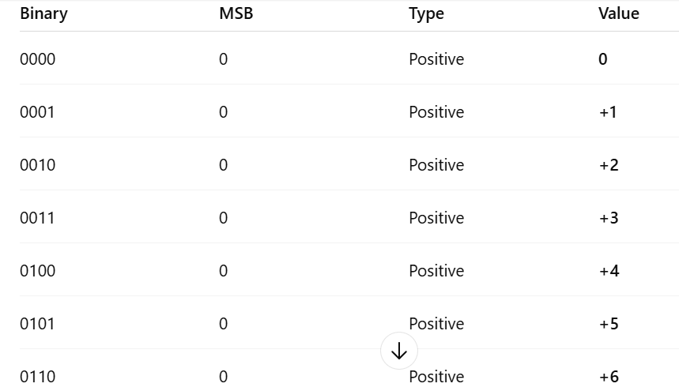
In 2’s complement representation, the most significant bit (MSB) is used as the sign bit:0 = positive1 = negativeFor 4-bit numbers, we have 2⁴ = 16 possible binary combinations (from 0000 to 1111).

Slide 33
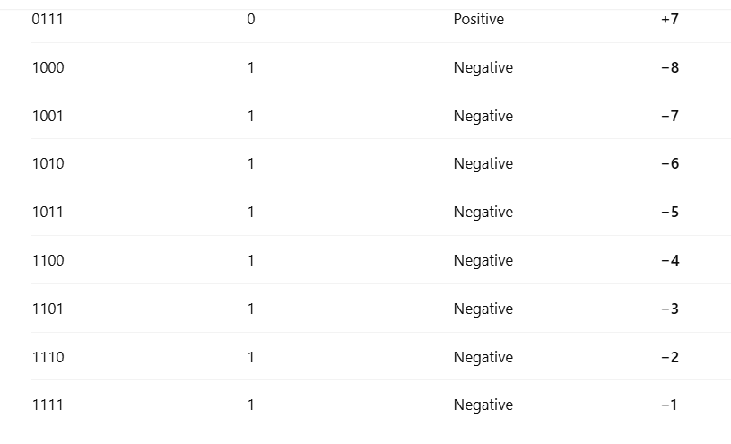

Slide 34
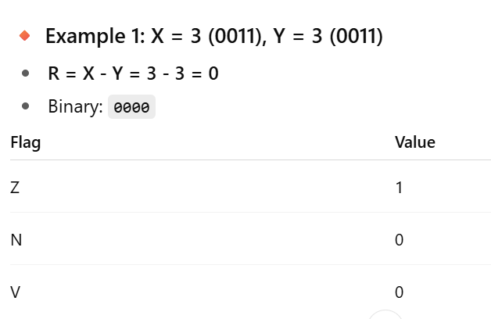
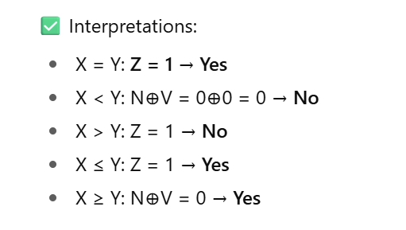
Signed 4-bit range (2's complement):
−8 to +7

Slide 35
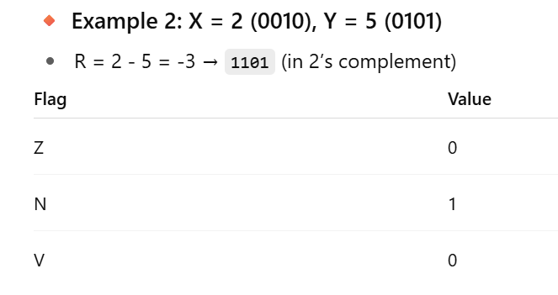
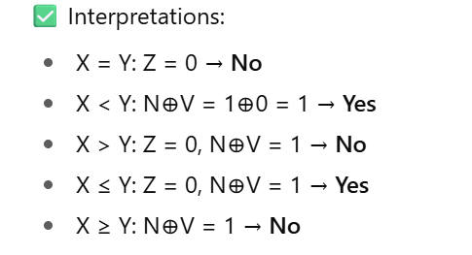

Slide 36
